Slide 1
Information for your child’s anxiety: Going back to school
The East Riding of Yorkshire Council
Child Psychological Wellbeing Service

Slide 2

What the sessions will look like:
What is anxiety?
Talking to your children
Tips to manage the anxiety
Getting your child back to school
Notes:
This power point covers tips to manage the anxiety

Slide 3
Creating a plan to get your child back to school one step at a time
By creating a plan, it helps you and your child to focus breaking down all the worries and anxieties around return back to school.

Slide 4
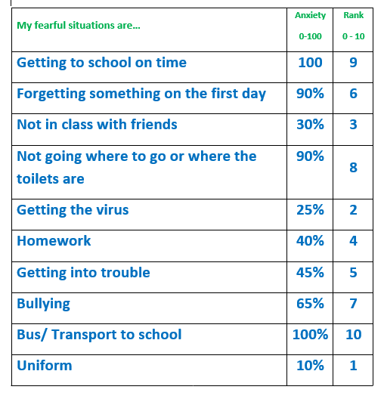
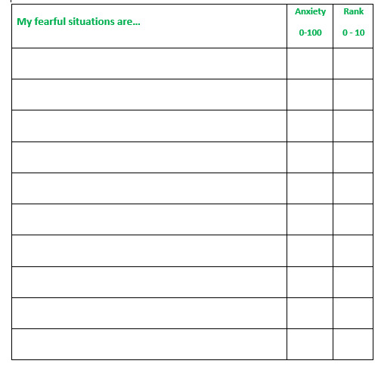
Ideas for the plan
Notes:
Voiceover:
Work with your child to list all the worries and anxieties they have around returning back to school. We have provided some examples of common worries that children can experience when returning back to school. Your child may have other worries or anxieties, work with you child to create a list of worries or anxieties around going back to school, rate them from 0 to 100% on how intense the worry or feeling is. Then rank them from 0 to 10 on what they find the easier/ less stressful to worst/ most stressful.
Explains on what to ask you child:
What worries you about going to school?
What do you think will happen when you go to school?
What is the worst thing that could happen?

Slide 5
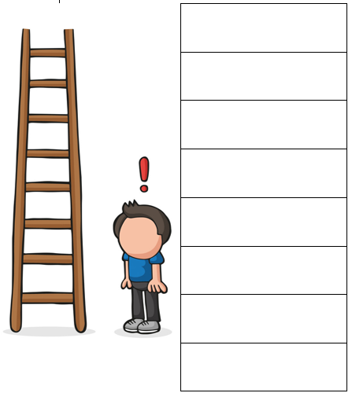
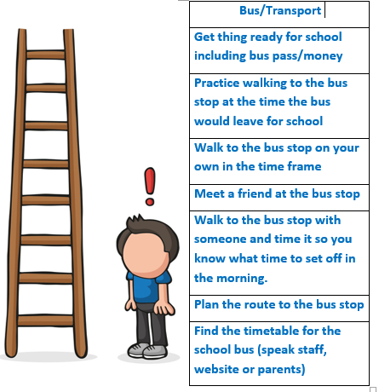
Developing your own plan
Notes:
Voiceover: This example demonstrates a child being worried or anxious around getting on the bus to go to school. You and your child need to create this together as each child’s worry will be different. Each step needs to be small but slowly increasing in difficult for your child. A good way to find out how difficult they find each task would be to ask them how anxious it makes them feel. Put the easiest task at the bottom of the ladder and your goal at the top of the ladder as you are aiming towards facing the fear.
Each step will require practice.

Slide 6
Support and Motivation
A clear and positive message that your child needs to go to school.
Stay positive about school
Create morning and bedtime routine at least two weeks before going back to school
Limit fun activates during school hours
Speak with the school to get additional support
Notes:
Voiceover: There will be positives such as seeing friends, playing sports, doing their favourite subjects etc.
It’s important that you as parents do not do it all for your child as doing these plans will help them to build confidence and resilience.

Slide 7
Rewards
Praise
Favourite breakfast
Extra gaming time
Ice cream
Friends over for a sleepover
Staying up a little bit later
Night off chores
Kick about with parents
Favourite dinner
Takeaway
Day out with family
Going to the park
Small gift
Movie night
Baking
Board game night
Camping in the garden
Notes:
Voiceover: Something we would always encourage and comes first is the reward of praise. Please make sure you label your praise and it is clear.
Some examples of praise are:
Well done for planning the route to the bus stop
I’m really proud of you for walking to the bus top today
You’re working really hard to overcome your worries around the bus
Keep going with the tasks, you’re doing really well
I’m so pleased you are contacting your friend to meet at the bus stop tomorrow
Rewards do not have to cost money therefore we have attached a range of different rewards to help if you are struggling for ideas.

Slide 8
Useful Contacts
EHASH Early Help and Safeguarding Hub |  | Tel: 01482 395500
Hull and East Yorkshire MIND | https://www.heymind.org.uk/ | Tel: 01482 240200 Text: 07520 633447
CAMHS Child Adolescent Mental Health Services | http://camhs.humber.nhs.uk/ | EastRiding: 01482 303810 24hr Crisis Team: 01482 301701
NHS Advice numbers for medical issues | https://www.nhs.uk/using-the-nhs/nhs-services/urgent-and-emergency-care/nhs-111/ If you have difficulties communicating or hearing you can: Call 18001 111 on a text phone | Urgent medical problem but unsure what to do? Call 111, 24 hours a day 365 days a year.
F.I.S.H Families Information Support Hub |  | Tel: 01482 396469
Samaritans |  | Tel: 0330 094 5717 116 123 (Free)

