Slide 1
Information for your child’s anxiety: Going back to school
The East Riding of Yorkshire Council
Child Psychological Wellbeing Service

Slide 2

What the sessions will look like:
What is anxiety?
Talking to your children
Tips to manage the anxiety
Getting your child back to school
Notes:
This power point covers tips to manage the anxiety

Slide 3
Tips to manage your child’s anxiety
Mindfulness and Grounding
Problem solving
Structuring the worries
Activities
Notes:
Voiceover:
Grounding and mindfulness is about being aware and focusing on the task and staying present in the moment.

Slide 4
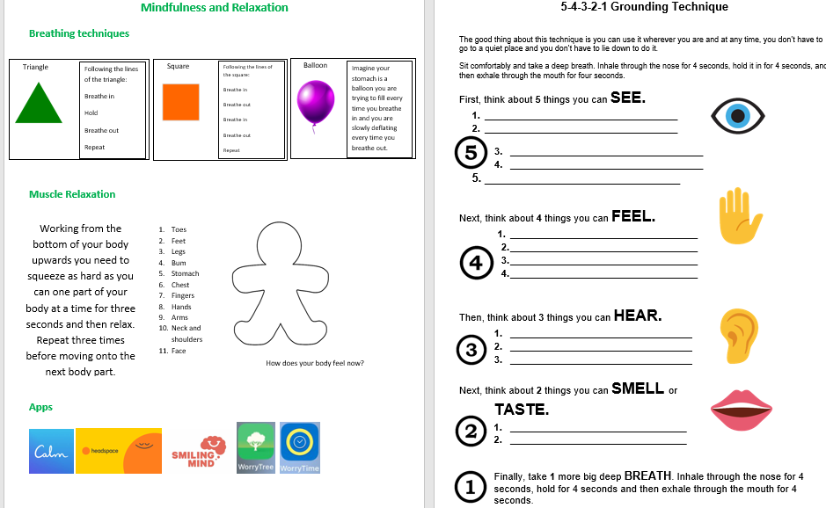
Grounding Mindfulness and

Slide 5
Problem Solving
Example:
What do I bring to school?
Don’t go to school. Bring everything I own. Ask a friend. Speak to parents. Contact school.
Ask a friend: Positive – they know the answer. Negative – they are more worried than me.
Solution: Speak to parent.
Plan: Look for letter from school, look on website.
Ask your child what is the problem?
Write down all the possible solutions (they can be unrealistic or outrageous)
Work out the positives and negatives of the solutions
Pick one of the solutions
Create a plan
Notes:
Voiceover:
Problem solving is a way for children to help figure out a way to solve the worries they can do something about.
Write down all the solutions to solving the worries and work out which would be the most beneficial and realistic solution.

Slide 6
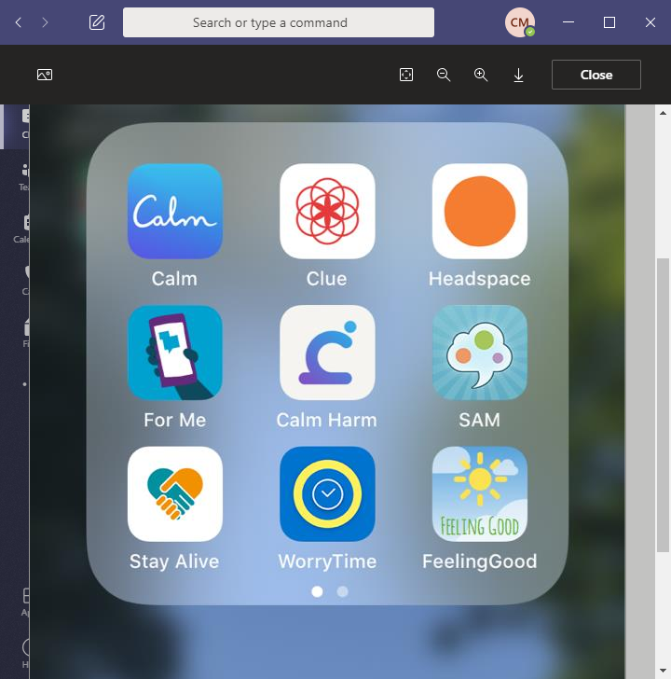
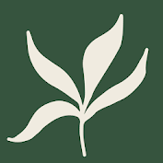
Structuring the worries
Plan a realistic time and location
Write down all your worries throughout the day and do something different.
Only think about the worries at the set time
Problem solve the worries
Notes:
Overview: Explain App

Slide 7
Activities
Music
Exercise
Talking to a friend and family
Walk
Drawing and colouring
Self care
Gaming
Cooking
Netflix, YouTube etc.
Caring for a pet
Tidying or Cleaning
Reading
Learn about something new
Do something you enjoy!

Slide 8
Useful Contacts
EHASH Early Help and Safeguarding Hub |  | Tel: 01482 395500
Hull and East Yorkshire MIND | https://www.heymind.org.uk/ | Tel: 01482 240200 Text: 07520 633447
CAMHS Child Adolescent Mental Health Services | http://camhs.humber.nhs.uk/ | EastRiding: 01482 303810 24hr Crisis Team: 01482 301701
NHS Advice numbers for medical issues | https://www.nhs.uk/using-the-nhs/nhs-services/urgent-and-emergency-care/nhs-111/ If you have difficulties communicating or hearing you can: Call 18001 111 on a text phone | Urgent medical problem but unsure what to do? Call 111, 24 hours a day 365 days a year.
F.I.S.H Families Information Support Hub |  | Tel: 01482 396469
Samaritans |  | Tel: 0330 094 5717 116 123 (Free)

